Slide 1




Sign Language synthesis by a decreasing granularity system from AZee
Paritosh Sharma June 26, 2023
CNRS, Université Paris-Saclay
paritosh.sharma@lisn.upsaclay.fr
1

Slide 2
Goals
Synthesize sign language using an avatar from a formal linguistic model
Increase the coverage of the synthesis
Naturalness of the synthesized animation
What does the animation model want from the linguistic model?
2

Slide 3
Background: Animating Sign Language
Create animation by concatenating(Pezeshkpour et al., 1999)
Example: Cat + I like
Problem: Need a pre-animated sign for every gloss
Solution: Procedural methods(GIBET et al., 2001)
Problem: Still linear
3

Slide 4
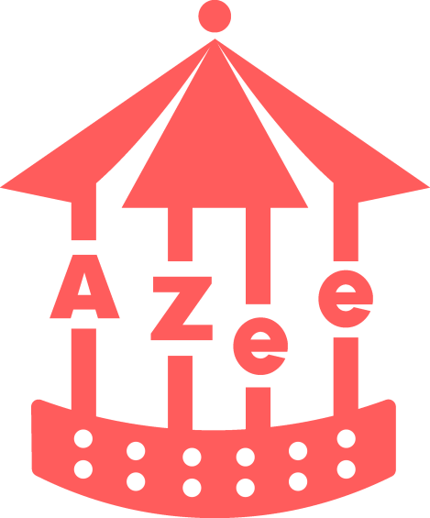
Background: AZee
Proposed by Filhol in 2014
Non-linear
Allows us to write parameterized signed forms for semantic functions
Generates a timeline
4

Slide 5
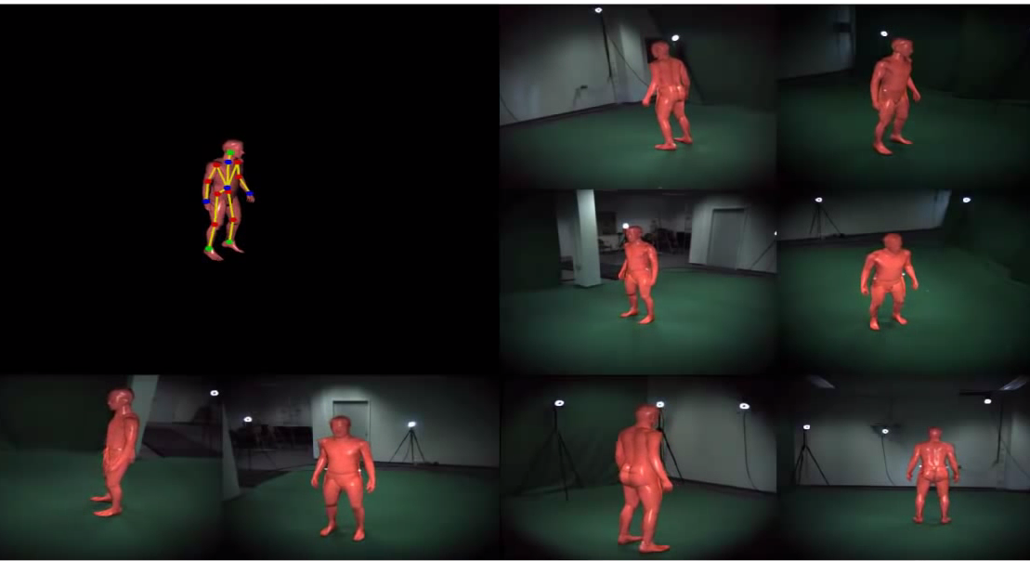
Background: Animation Techniques
Pre-animated(Mocap, Artist defined, etc.)
Labor intensive
Difficult to isolate signs(for Mocap)
Problems with Re-targeting
Silhouette tracking
Building from low-level
Robotic
5

Slide 6
Background: Animating with AZee
TOPIC
Cat
:info-about
'topic
:cat
'info
:cute
HAND_PLACE_TRILL.INFO
INFO
Cute
HAND_CONFIG.INFO
HOLD1
HOLD2
BLINK
6

Slide 7
Background: Building from low-level constraints for :cute
More Blocks
Posture Constraints
:cute
(static)
(dynamic)
Place hand on abdomen
Orient…
Transition
Transpath
Trill or Shake the hand along an axis
7

Slide 8
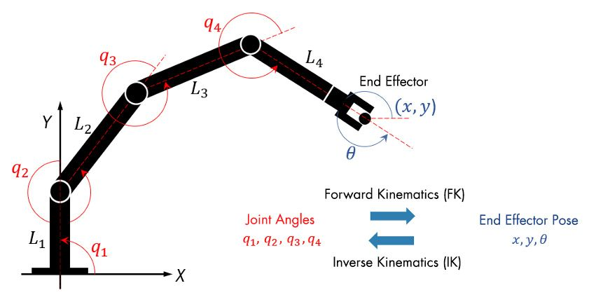
Background: IK vs FK
Inverse Kinematics Problems contained in a block
8
Source: https://www.mathworks.com/discovery/inverse-kinematics.html

Slide 9
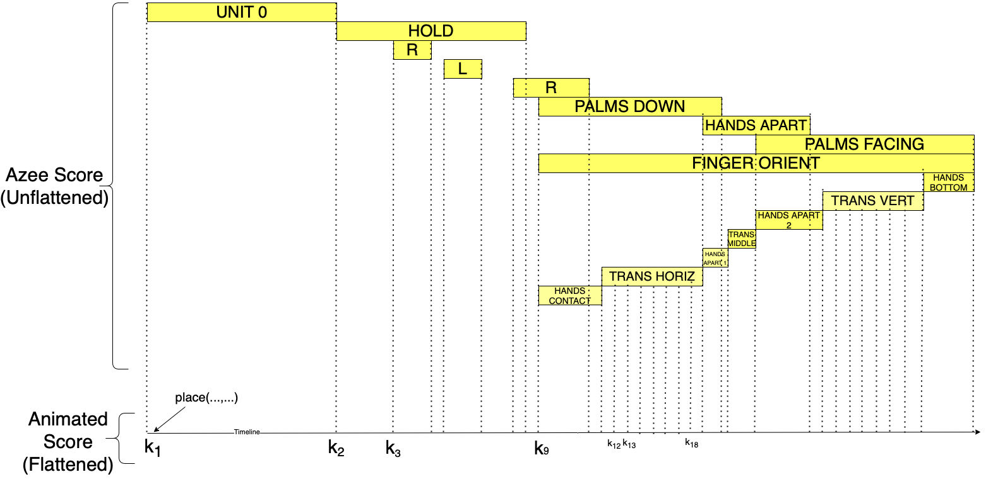
Problem: Flattening
Generate key poses along the boundaries of the block to simplify clashes
Information loss
Flattening in :nicht-sondern(:arbre, :armoire)
9

Slide 10
Solution: Ordering the blocks
Create a dependency acyclic graph based on block dependencies.
Topologic sorting for evaluation order.
Wrist movement 1
Transition(interpolation ) 1
Configuration
…
Wrist movement 2
10
11/22

Slide 11
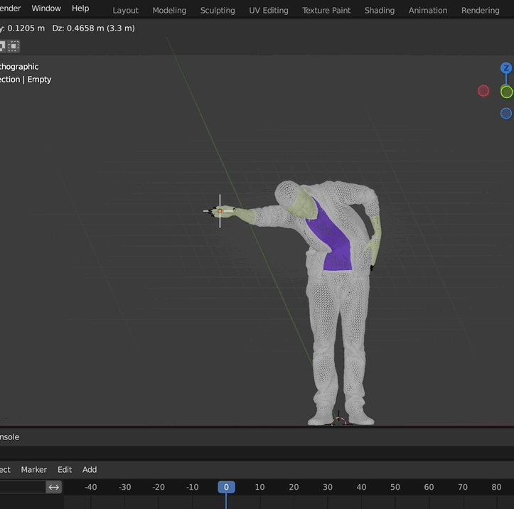
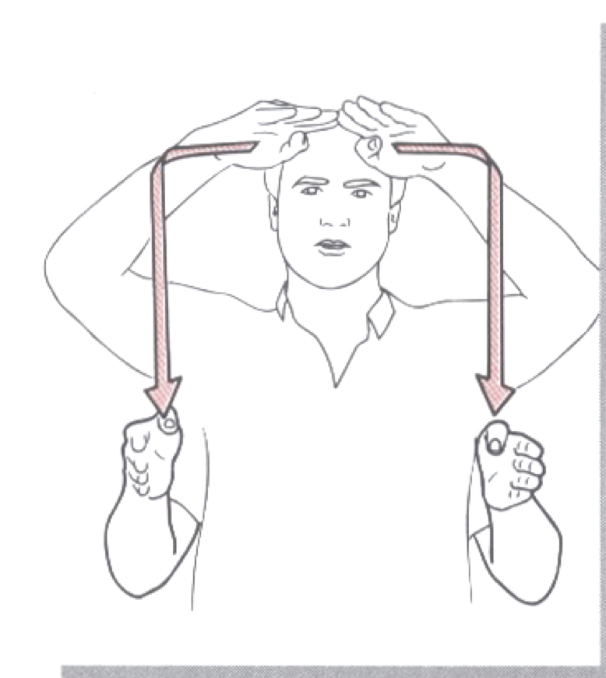
Problem
Restriction using IK and joint limits only
Loss of chain when evaluating transpaths
How to extend low-level constraints?
Marionette effect during IK
Source: Moody(1997
11

Slide 12
Solution: Layers
Define separate layers based on the constraint evaluation.
Order constraints in the blocks based on dependencies.
Apply constraint on a specific layer and update the layer.
12

Slide 13
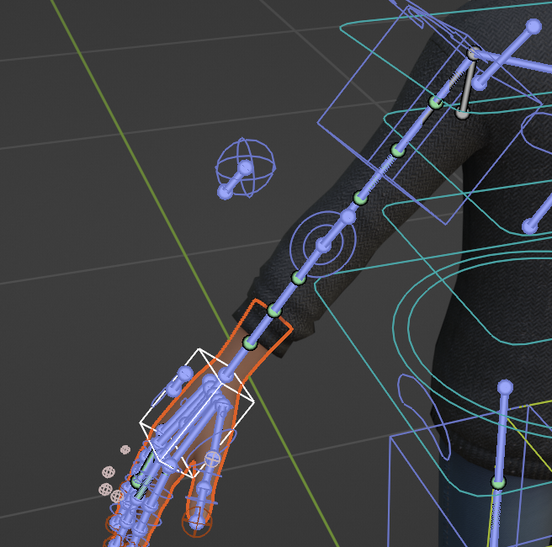
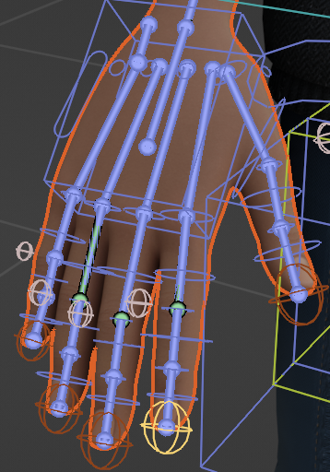
IK Layer
IK layer for hands, fingers and spine.
Reuse the same chain for transpath evaluation.
Hand IK chain
Finger IK chain
13

Slide 14
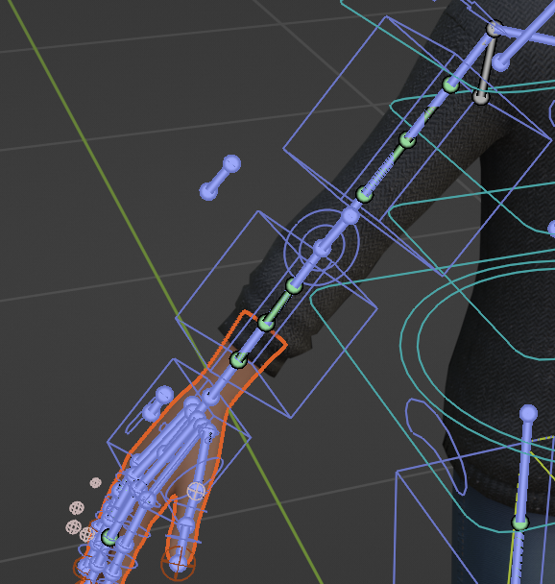
FK Layer
Used for evaluating forward kinematics such as orient, trill.
FK for hand
14
11/22

Slide 15
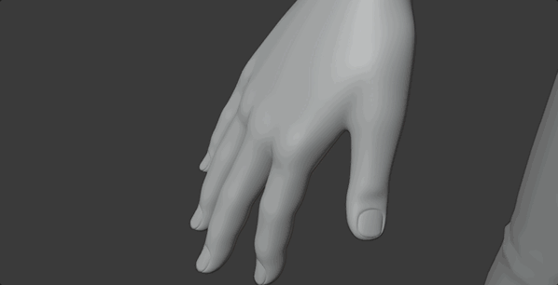
Morphs
Morphs for hands and face
Morph for index_r
15
11/22

Slide 16
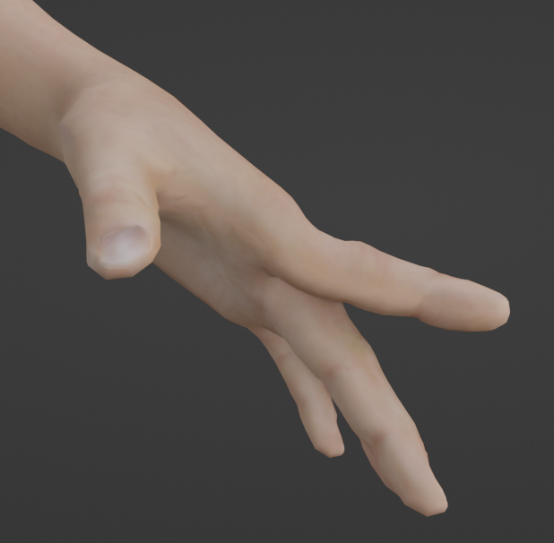
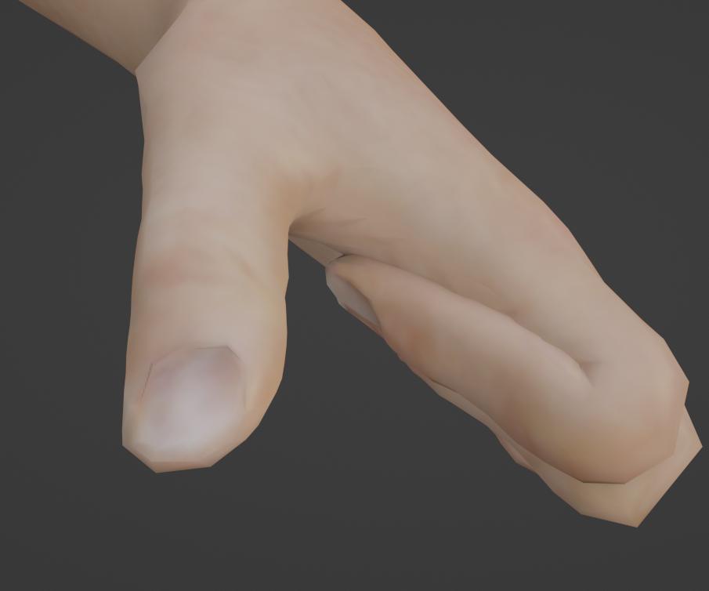
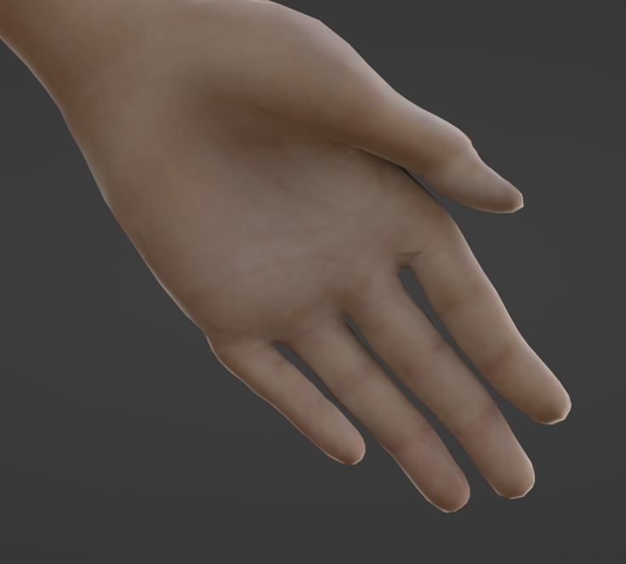
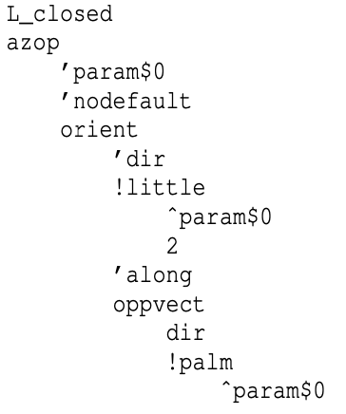
Problem
Unnatural shape generation
16
11/22

Slide 17
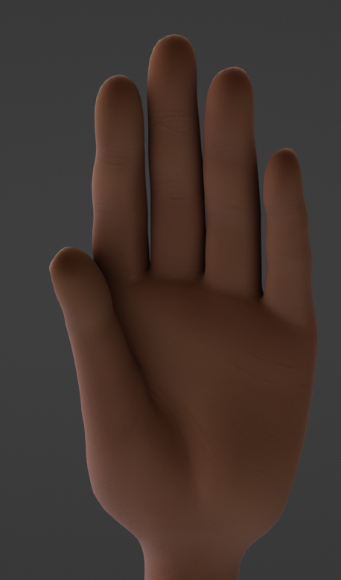
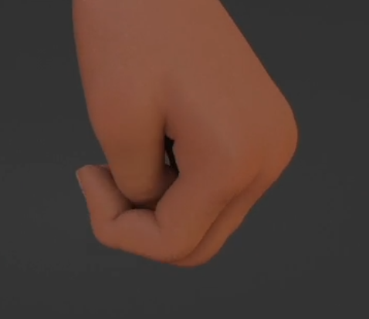
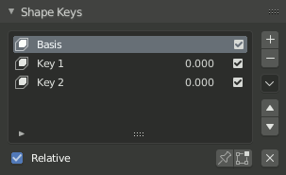
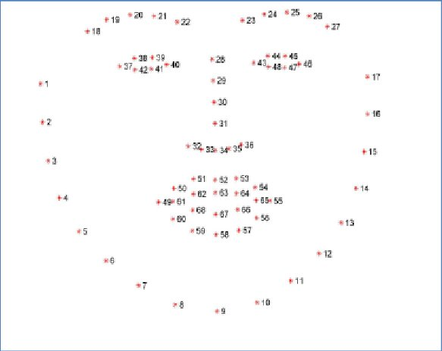
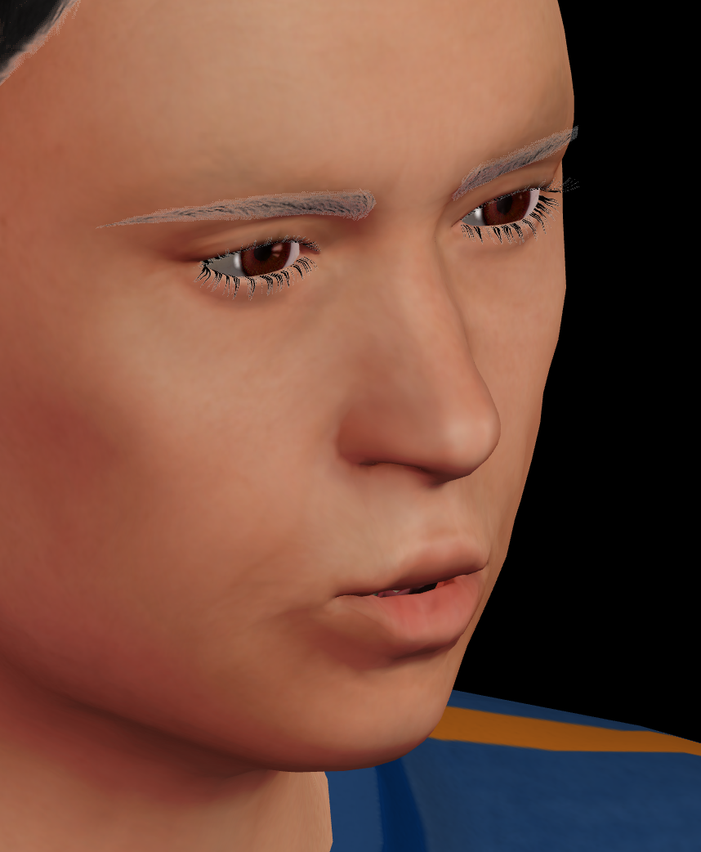
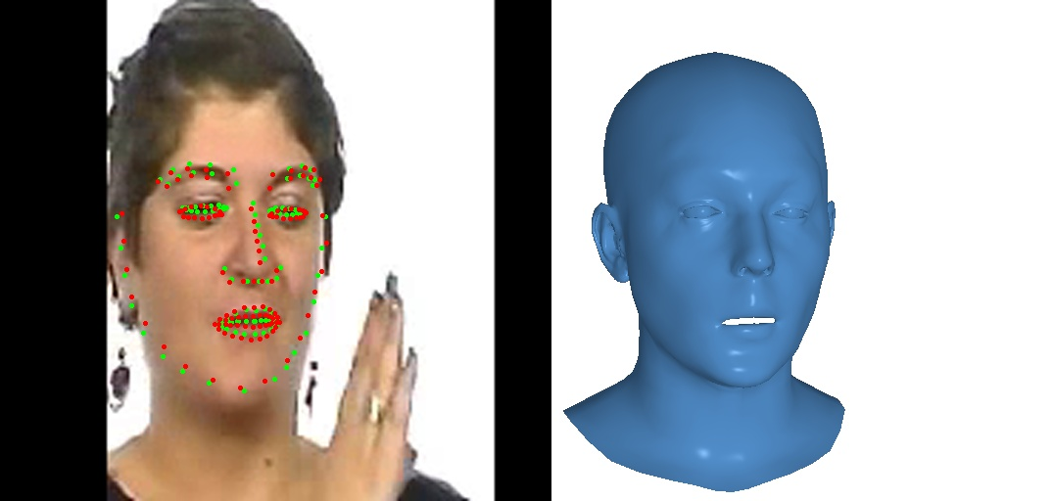
Solution: Morphs
morph ’morph id
weight [0 , 1]
Morphs defines as ->
Skeletal morphs for hands
Non skeletal morphs for face
Shape keys
Landmarks
Expression for
:inter-subjectivity
FLAME
17

Slide 18
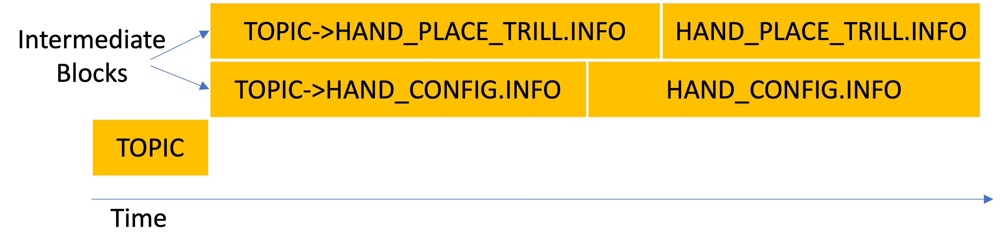
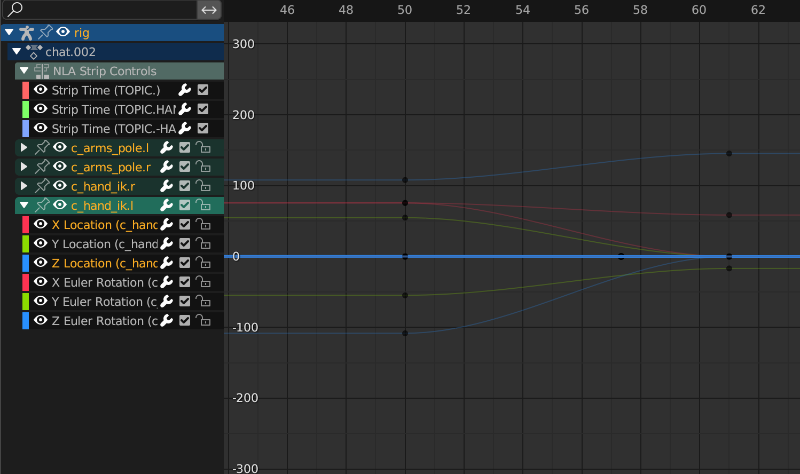
Motion Templates
Problem: Linear interpolation between blocks looks robotic
Solution: Generate intermediate transition blocks based on a pre-defined motion template
Intermediate blocks
F-Curves
18
11/22

Slide 19
Implementation and Preliminary Results
19

Slide 20
Future Work
Evaluation
Parameterizing the pre-animated motion data
Address retargeting problems(SMPL-X)
Projection of low-level constraints to the motion space of more natural blocks.
Testing and debugging our blender add-on for longer discourses.
Integrating with AZVD.
20
11/22

Slide 21
Other activities during the PhD
134 hours of teaching in English and French (Graphics, AI, Java, HCI, Database)
Formations on Sign Language, Open Science, Climate Change, Pedagogy
3 Minute Thesis competition
Poster presentation at PhD day
21
11/22

Slide 22
Thank you
And
Questions?
22

